Slide 1

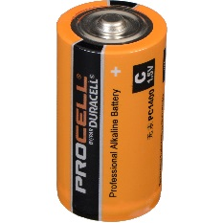
BATTERY MODELING: WHY BATTERY MODELING?
Used to Monitor Battery parameters such as SOC
Input Current
Output Voltage
Battery Model
Error ~ 0
http://epg.eng.ox.ac.uk/tags/battery-modelling-state-charge-battery-management-system
Notes:
The first step in designing a battery management system (BMS) is to develop a high fidelity battery model. In order for a BMS to estimate the battery critical parameters such as the battery state of charge and state of health, an accurate battery model has to be implemented on board of the BMS along with a robust estimation strategy. So a battery model is a list of mathematical equations that describe what’s physically happening inside the battery. In simple terms, as shown in the figure, if we apply the same current profile to the battery and the battery model, both should generate the same voltage profile and the error between the two signals should be close to zero. The model can predict the behavior of the battery in a way that if we applied an estimator, we can predict critical parameters such as the battery SOH and remaining useful life.

Slide 2
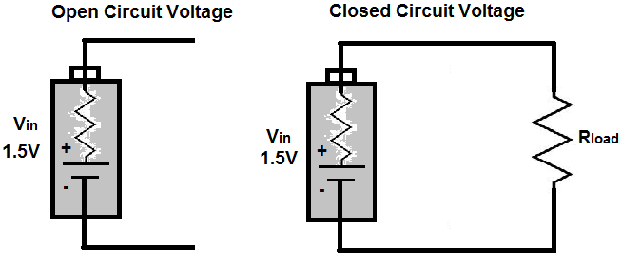
OPEN CIRCUIT VOLTAGE: DEFINITION
The Open-circuit voltage (OCV) is the difference of electrical potential between two terminals of a device when the device is disconnected from any circuit.
There is no external load connected.
No external electric current flows between the terminals.
http://www.learningaboutelectronics.com/Articles/What-is-open-circuit-voltage.php
Notes:
The Open-circuit voltage (OCV) is the difference of electrical potential between two terminals of a device when the device is disconnected from any circuit. There is no external load connected and no external electric current flows between the terminals.
The Open Circuit Voltage (OCV) represents a Voltage Source's Full Voltage, since there is no voltage drop across the load. A voltage source's OCV represents its full voltage value, since the source does not share any of its voltage with a load.
The unconnected voltage is real voltage, even if a voltage source is unconnected and not attached to any load, the potential power still exists.

Slide 3
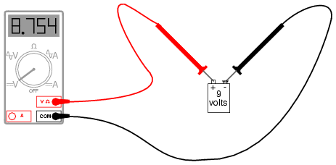

OPEN CIRCUIT VOLTAGE:
Example: Battery Open Circuit Voltage
If you measure the voltage of the battery terminals with a multi-meter, you will read the OCV even if there is no current is flowing in the circuit.
The OCV is function of the battery State-of-Charge (SOC).
http://www.allaboutcircuits.com/textbook/direct-current/chpt-3/safe-meter-usage/
http://www.learningaboutelectronics.com/Articles/What-is-open-circuit-voltage.php
https://www.yourmechanic.com/article/how-to-check-the-voltage-of-a-car-battery
Notes:
- So in case of batteries, if you measure the voltage of the battery terminals with a multi-meter, you will read the OCV even if there is no current is flowing in the circuit.
- The battery OCV is particularly important since there is a relationship that exists between the battery State-of-Charge (SOC) and Open Circuit Voltage (OCV).

Slide 4
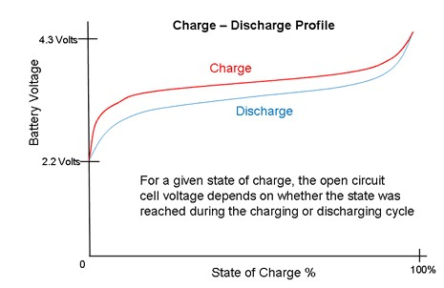
OPEN CIRCUIT VOLTAGE: SOC-OCV RELATIONSHIP
There is a relationship between the battery Open-circuit voltage (OCV) and State of Charge (SOC).
The relationship depends on the battery chemistry and the direction of charging and discharging.
AVERAGING
http://www.honcell.com/faq/index-9.html
http://www.learningaboutelectronics.com/Articles/What-is-open-circuit-voltage.php
Notes:
- There is a relationship between the battery Open-circuit voltage (OCV) and State of Charge (SOC). The relationship depends on the battery chemistry and the direction of charging and discharging. If you start with a fully discharged battery and start charging it, the battery OCV starts at let’s say 2.2V and keep ramping up following the red line until you reach the maximum voltage at 4.3V. The battery SOC is set to 100% when the battery is fully charged. As you start discharging the battery, you start from a fully charged state then you follow a different path indicated by the blue line until you fully discharge the battery at 0% SOC. The difference between the charging and discharging paths is due to hysteresis. In the following section we will know how to experientially derive the battery open circuit voltage-state of charge relationship from experimental data.

Slide 5
OPEN CIRCUIT VOLTAGE: VOLTAGE-BASED SOC/SOC-OCV RELATIONSHIP IMPORTANCE
This relationship is important because it can be used to infer the SOC from the OCV.
This technique is called voltage-based SOC Estimation.
MEASURE OCV
KNOW SOC
http://www.learningaboutelectronics.com/Articles/What-is-open-circuit-voltage.php
Notes:
- This relationship is important because it can be used to infer the SOC from the OCV.
- This technique is called voltage-based SOC Estimation. In simple terms, if we can accurately measure the battery open circuit voltage, we can use this relationship to know the battery state of charge.

